Slide 1

CERTIFICATE III IN AUTOMOTIVE REPAIR & MAINTENANCE
SUBJECT: VEHICLE MAINTENACE AND REPAIR
By Ibrahim siraj
Maldives polytechnic

Slide 2
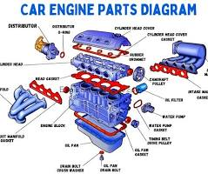
VEHICLE MAINTENACE AND REPAIR
Chapter 1 Understand Automotive Engine Components and Workshop Safety
Automotive Engine Components
Automotive engine components include the engine block, cylinder head, pistons, connecting rods, crankshaft, and camshaft. Other important parts are the valves, spark plugs, fuel injectors, timing belt or chain, and the cooling and lubrication systems. These components work together to convert fuel into the power needed to run a vehicle
By Ibrahim siraj
Maldives polytechnic

Slide 3
VEHICLE MAINTENACE AND REPAIR
Chapter 1 Understand Automotive Engine Components and Workshop Safety
Introduction
The internal combustion engine (IC engine) converts chemical energy of fuel into mechanical energy.
Combustion takes place inside the cylinder.
Used in cars, bikes, generators, ships, and aircraft.
Two main types:
Petrol (Spark Ignition) Engine
Diesel (Compression Ignition) Engine
By Ibrahim siraj
Maldives polytechnic

Slide 4
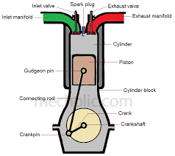
VEHICLE MAINTENACE AND REPAIR
Chapter 1 Understand Automotive Engine Components and Workshop Safety
Basic Working Principle
The engine works on the principle of combustion of fuel-air mixture to produce expanding gases.
These gases push the piston, converting heat energy → mechanical energy.
The motion of the piston is transferred to the crankshaft via the connecting rod, producing rotary motion
By Ibrahim siraj
Maldives polytechnic

Slide 5
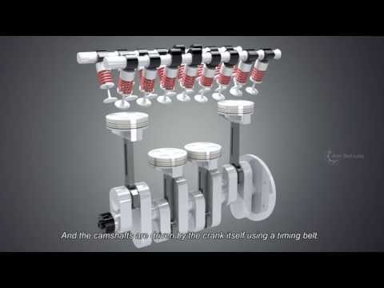
VEHICLE MAINTENACE AND REPAIR
Chapter 1 Understand Automotive Engine Components and Workshop Safety
Basic Working Principle
By Ibrahim siraj
Maldives polytechnic

Slide 6
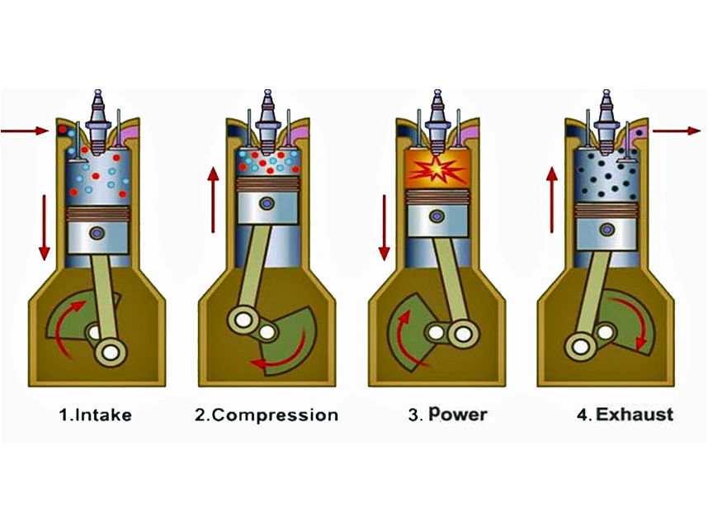
VEHICLE MAINTENACE AND REPAIR
Chapter 1 Understand Automotive Engine Components and Workshop Safety
The Four-Stroke Cycle
Most modern engines operate on a Four-Stroke Cycle, discovered by Nikolaus Otto (1876).
The four strokes are:
1- Intake (Suction) Stroke
2- Compression Stroke
3- Power (Expansion) Stroke
4- Exhaust Stroke
By Ibrahim siraj
Maldives polytechnic

Slide 7
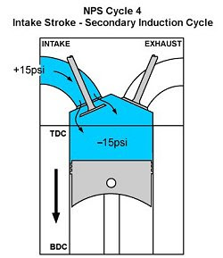
VEHICLE MAINTENACE AND REPAIR
Chapter 1 Understand Automotive Engine Components and Workshop Safety
The Four-Stroke Cycle
1. Intake (Suction) Stroke
Piston moves downward.
Inlet valve opens, exhaust valve closes.
Air-fuel mixture (in petrol engine) or air (in diesel engine) enters the cylinder.
Objective: Fill cylinder with charge for combustion.
By Ibrahim siraj
Maldives polytechnic

Slide 8
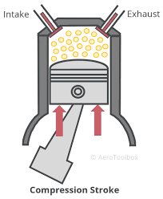
VEHICLE MAINTENACE AND REPAIR
Chapter 1 Understand Automotive Engine Components and Workshop Safety
The Four-Stroke Cycle
2. Compression Stroke
Both valves closed.
Piston moves upward, compressing the mixture (or air).
Compression increases pressure and temperature inside the cylinder.
At the end of this stroke:
Petrol Engine: Spark plug ignites the mixture.
Diesel Engine: Fuel is injected and ignites due to heat of compression.
By Ibrahim siraj
Maldives polytechnic

Slide 9
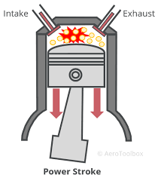
VEHICLE MAINTENACE AND REPAIR
Chapter 1 Understand Automotive Engine Components and Workshop Safety
The Four-Stroke Cycle
3. Power (Expansion) Stroke
Combustion occurs, producing high-pressure gases.
The expanding gases push the piston downward.
This is the only stroke that produces power.
Crankshaft converts this movement into rotational energy.
By Ibrahim siraj
Maldives polytechnic

Slide 10
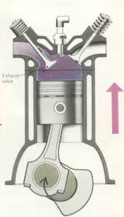
VEHICLE MAINTENACE AND REPAIR
Chapter 1 Understand Automotive Engine Components and Workshop Safety
The Four-Stroke Cycle
4. Exhaust Stroke
Exhaust valve opens, inlet valve closes.
Piston moves upward, pushing out the burnt gases.
Cylinder becomes ready for the next cycle.
By Ibrahim siraj
Maldives polytechnic

Slide 11
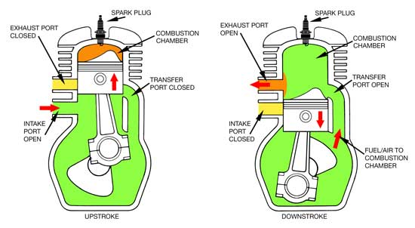
VEHICLE MAINTENACE AND REPAIR
Chapter 1 Understand Automotive Engine Components and Workshop Safety
Two-Stroke Engine Principle (Optional Slide)
In a two-stroke engine, all four operations occur in two piston strokes (one revolution of crankshaft).
Advantages: Simple design, lightweight, more power for size.
Used in: Motorbikes, scooters, chainsaws.
Disadvantages: Less fuel efficient, more pollution
By Ibrahim siraj
Maldives polytechnic

Slide 12
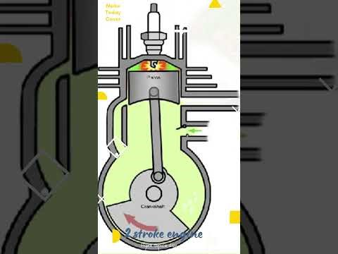
VEHICLE MAINTENACE AND REPAIR
Chapter 1 Understand Automotive Engine Components and Workshop Safety
Two-Stroke Engine Principle (Optional Slide)
By Ibrahim siraj
Maldives polytechnic

Slide 13
VEHICLE MAINTENACE AND REPAIR
Chapter 1 Understand Automotive Engine Components and Workshop Safety
Energy Conversion in Engine
Process | Energy Type | Conversion
Combustion | Chemical → Thermal | Burning fuel-air mixture
Expansion | Thermal → Mechanical | Gas expansion pushes piston
Crankshaft Rotation | Mechanical | Drives wheels or machinery
By Ibrahim siraj
Maldives polytechnic

Slide 14
VEHICLE MAINTENACE AND REPAIR
Chapter 1 Understand Automotive Engine Components and Workshop Safety
Key Components in Operation
Piston: Converts gas pressure into motion
Valves: Control air/fuel intake and exhaust
Spark Plug / Injector: Initiates combustion
Crankshaft: Converts reciprocating to rotary motion
Flywheel: Smooths engine rotation
By Ibrahim siraj
Maldives polytechnic

Slide 15
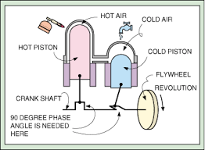
VEHICLE MAINTENACE AND REPAIR
Chapter 1 Understand Automotive Engine Components and Workshop Safety
Working Principle Diagram
By Ibrahim siraj
Maldives polytechnic

Slide 16
VEHICLE MAINTENACE AND REPAIR
Chapter 1 Understand Automotive Engine Components and Workshop Safety
Comparison: Petrol vs Diesel Operation
Feature | Petrol Engine | Diesel Engine
Air-Fuel Mixing | Before intake (carburetor/injector) | Inside cylinder
Ignition | Spark plug | Compression heat
Compression Ratio | 6:1 – 10:1 | 14:1 – 22:1
Efficiency | Lower | Higher
By Ibrahim siraj
Maldives polytechnic

Slide 17
VEHICLE MAINTENACE AND REPAIR
Chapter 1 Understand Automotive Engine Components and Workshop Safety
Summary
Engine operation is based on conversion of fuel energy to mechanical work.
The four-stroke cycle ensures efficient use of fuel.
Understanding this principle is key to designing and maintaining engines
By Ibrahim siraj
Maldives polytechnic

Slide 18
VEHICLE MAINTENACE AND REPAIR
Chapter 1 Understand Automotive Engine Components and Workshop Safety
Conclusion
The IC engine is a remarkable innovation that powers modern transportation.
Though efficient, focus is shifting toward hybrid and electric technologies for a cleaner future.
By Ibrahim siraj
Maldives polytechnic

Slide 19
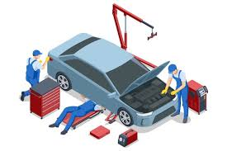
VEHICLE MAINTENACE AND REPAIR
Chapter 1 Understand Automotive Engine Components and Workshop Safety
Workshop Safety
Engine workshop safety involves using proper personal protective equipment (PPE), maintaining a clean and organized workspace, and following safe procedures to mitigate risks from fire, heavy equipment, hazardous materials, and moving parts.
It includes securing the vehicle, using correct lifting techniques for heavy components, handling flammable substances with care, and ensuring all tools and machinery are in good working order
By Ibrahim siraj
Maldives polytechnic

Slide 20
VEHICLE MAINTENACE AND REPAIR
Chapter 1 Understand Automotive Engine Components and Workshop Safety
Workshop Safety
Personal protective equipment (PPE)
Wear goggles and gloves to protect your eyes from chemical splashes and flying debris, and your hands from sharp objects, chemicals, and heat.
Use hearing protection in noisy areas to prevent hearing damage.
Wear appropriate clothing, such as long-sleeved shirts and pants, and avoid loose clothing that could get caught in machinery.
Wear closed-toe shoes to protect your feet from dropped objects.
Remove jewelry like rings, necklaces, and watches to prevent them from getting caught in moving part
By Ibrahim siraj
Maldives polytechnic

Slide 21
VEHICLE MAINTENACE AND REPAIR
Chapter 1 Understand Automotive Engine Components and Workshop Safety
Workshop Safety
Workplace and equipment safety
Keep the area clean and organized to prevent slips, trips, and falls.
Ensure the area is well-lit and ventilated, especially when running an engine, to prevent a buildup of toxic fumes.
Use the right tool for the job and ensure all tools and equipment are in good working order.
Secure the vehicle properly on jack stands or ramps before working underneath it to prevent it from falling.
Securely store flammable liquids and keep them away from heat sources or sparks.
Disconnect the battery before working on electrical systems.
Keep hands away from moving parts, such as fans and belts, and tie back long hai
By Ibrahim siraj
Maldives polytechnic

Slide 22
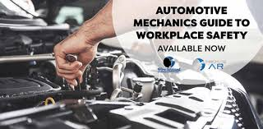
VEHICLE MAINTENACE AND REPAIR
Chapter 1 Understand Automotive Engine Components and Workshop Safety
Workshop Safety
Procedures and awareness
Never work on a hot engine to avoid burns.
Be aware of potential hazards, such as hot surfaces, flammable materials, and electrical shock.
Handle hazardous materials carefully and clean up any spills immediately.
Use proper lifting techniques and equipment for heavy parts to prevent back injuries.
Follow manufacturer instructions and be mindful of specific safety warnings for different engines.
Do not smoke or drink alcohol in the workshop.
Report all accidents and unsafe conditions to a supervisor.
Know the location of fire extinguishers and understand fire drill procedure
By Ibrahim siraj
Maldives polytechnic

Slide 23
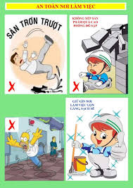

VEHICLE MAINTENACE AND REPAIR
Chapter 1 Understand Automotive Engine Components and Workshop Safety
Workshop Safety
By Ibrahim siraj
Maldives polytechnic

Slide 24
VEHICLE MAINTENACE AND REPAIR
Chapter 1 Understand Automotive Engine Components and Workshop Safety
References
Internal Combustion Engines by V. Ganesan
Automobile Engineering by Kirpal Singh
Technical manuals: Honda, Cummins, Toyota
By Ibrahim siraj
Maldives polytechnic

Slide 25
THANK YOU

